Slide 1
Shutting Down the Trauma to Prison Pipeline
Early, Appropriate Care for Child-Welfare Involved Youth
Kate Lowenstein, Multisystem Youth Project Director

Slide 2
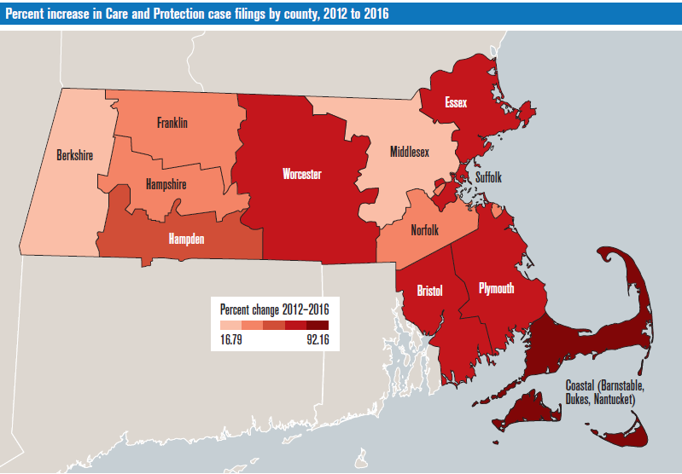
Care and Protection Increase Map
Notes:
To re-size and image without losing the ratio: Right click on the image – choose “Size and Position”, and click on “Lock Aspect Ratio”

Slide 3
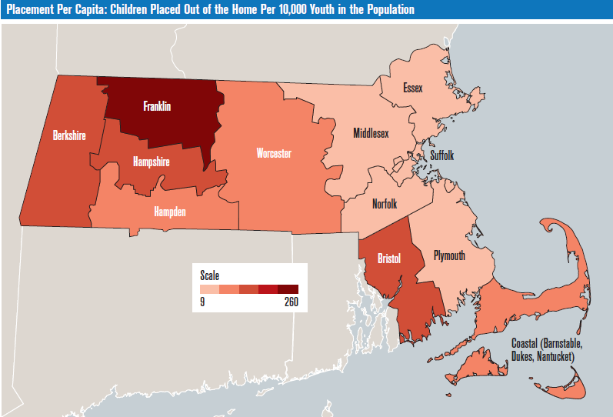
Kids in Placement (Per Capita)
Notes:
To re-size and image without losing the ratio: Right click on the image – choose “Size and Position”, and click on “Lock Aspect Ratio”

Slide 4
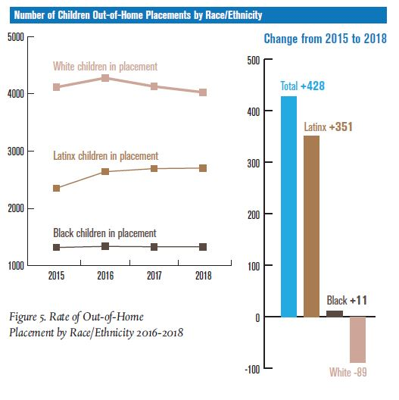
Increase in Out-of-Home Placements by Race/Ethnicity
Notes:
The data shows a clear disproportionate impact on the Latinx community in terms of children removed from homes. Latinx children accounted for 82% of the increase in children in out of home placement. All races were impacted in the increase in 2016 but as other races/ethnicities went down the Latinx numbers continued to increase each year.
This is all within the context of Massachusetts having the worst inequality between white and latino residents of any state in terms of income, housing, poverty, unemployment, incarceration, and educational attainment. In terms of youth in Massachusetts Latinox have the highest relative rate of probation, detention, and commitment to DYS.

Slide 5
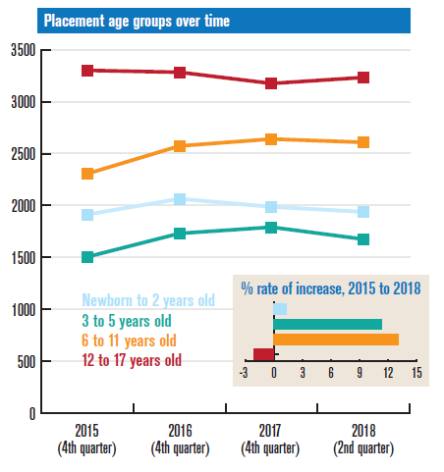
Children in Placement by Age
Notes:
the trend increase is the 6-11 age group in placement – these are school age children.

Slide 6
Continuous Time In Placement
Notes:
Continuous time in placement does not mean the same placement
Administration of Children and Families HHS - reports which counts placement stability as 2 or fewer placements by time in care – MA had average of 3 - has a high rate of instability
The two categories that have been steadily going up are 2-4 years and 4+ years.

Slide 7
Children Under 18 in DCF Caseload, 2018
Notes:
Large number of very young kids who are dcf involved but still at home. This is significant as these children have experienced some form of harm causing child welfare involvement in their lives. These are children we also need to be aware of among us.

Slide 8
Contact
Shutting Down the Trauma Pipeline report cfjj.org/trauma-to-prison
katelowenstein@cfjj.org
617.338.1050
Join our email list cfjj.org/jj-news

